Slide 1

PROJECT ANALYSIS
HGTV
BEST COUNTY TO RAISE A FAMILY

Slide 2
Criteria
The following are categories we looked into to help us gain insight on the best county to raise a family.
Housing
Crime
Income
Education

Slide 3
Making the Analysis
We understand that many families may considered other traits more important when choosing a place to live but we thought it was best to score each criteria similarly.
HGTV went about it with a score of 10. We gave 10 points to each county that reach first place in their respective category.
9 points to second place and so on.

Slide 4
Housing Data
Chou

Slide 5
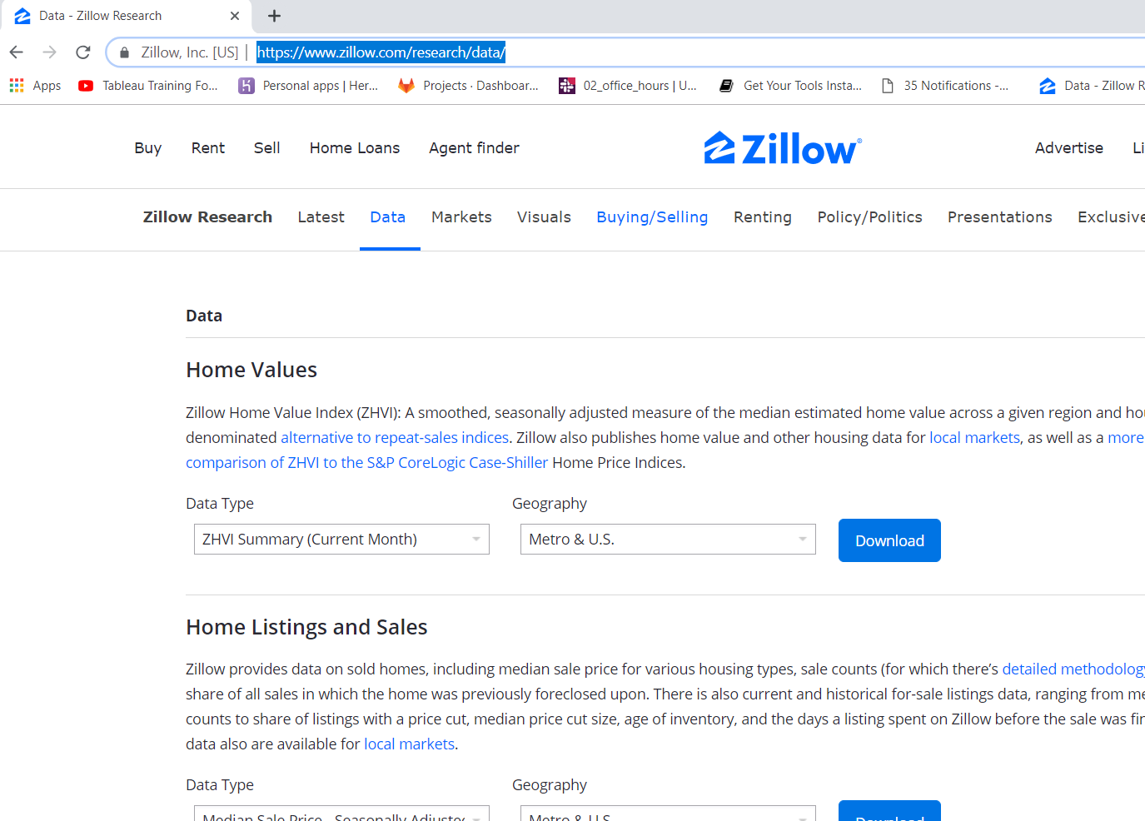
Housing Data
Zilliow
https://www.zillow.com/research/data/

Slide 6
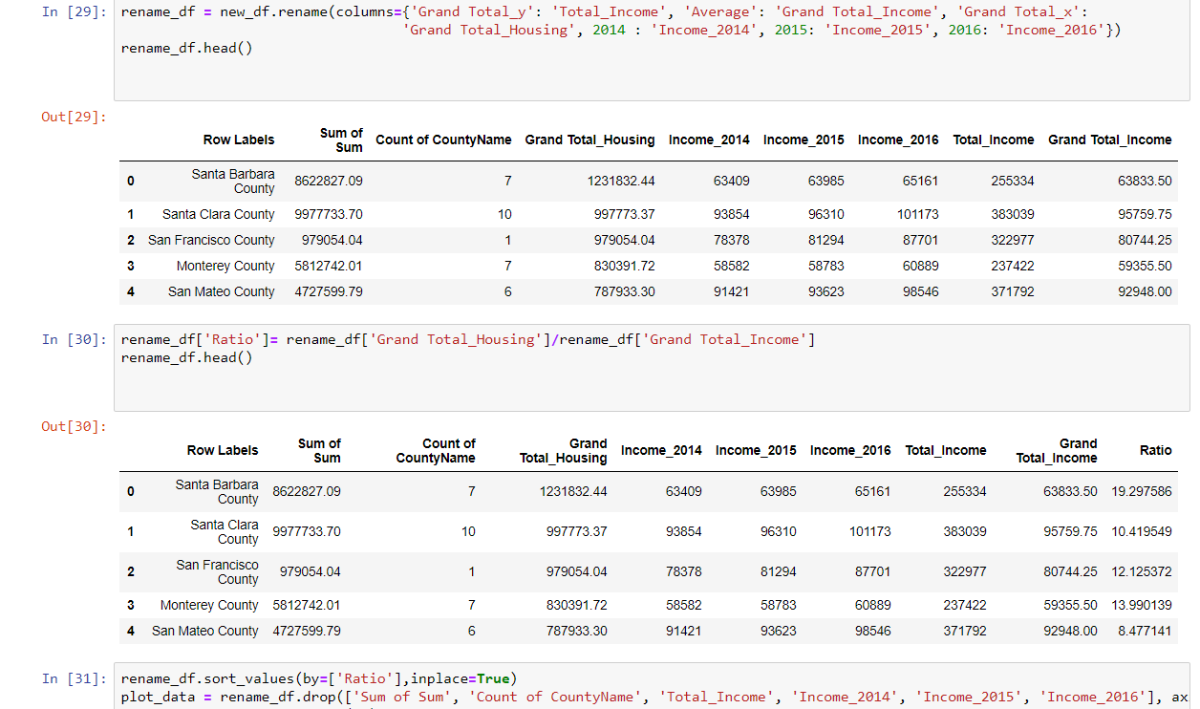
Data Clean up
Exel
Python

Slide 7
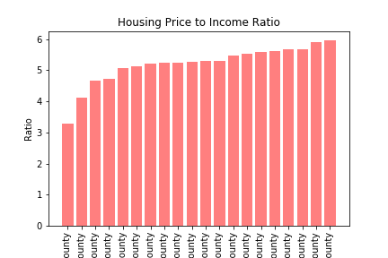

Slide 8
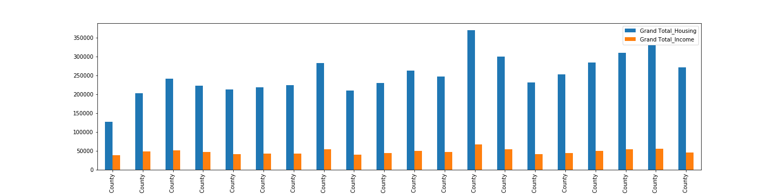

Slide 9
Crime rate vs Income
Tjetjep

Slide 10
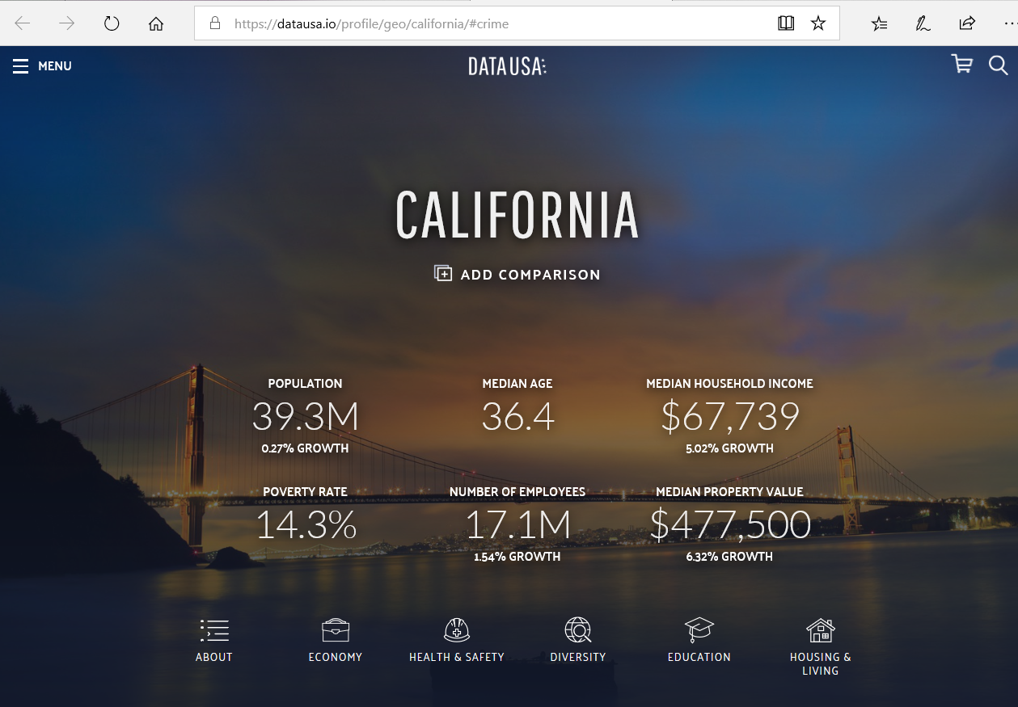
Data Source

Slide 11
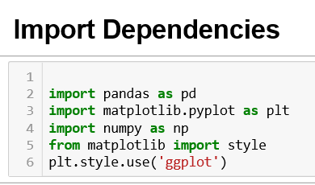
Import Dependencies

Slide 12
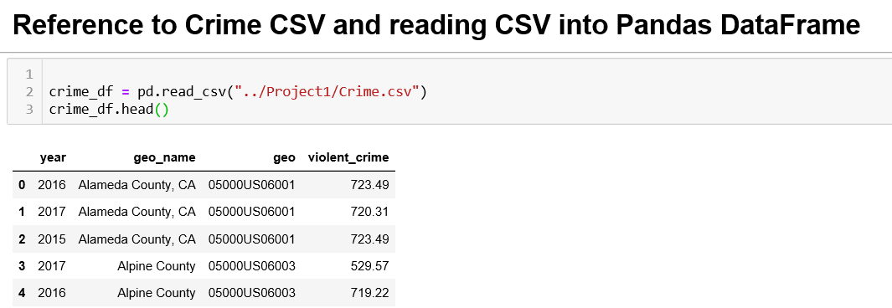
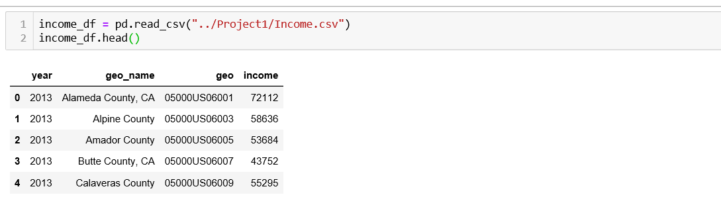
Import Data into Pandas DataFrame

Slide 13
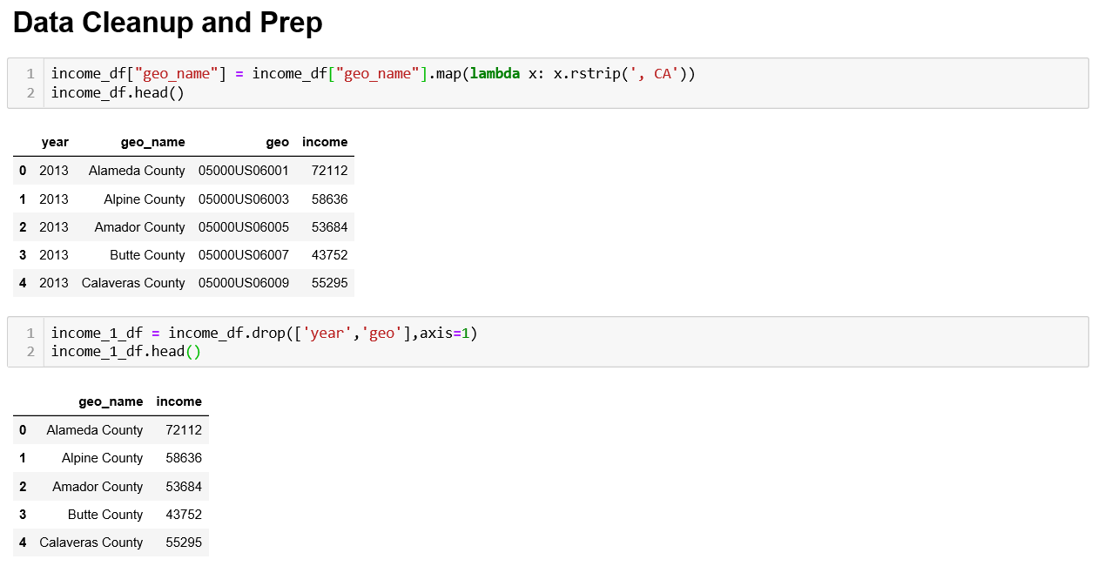
Data Cleanup and Prep

Slide 14
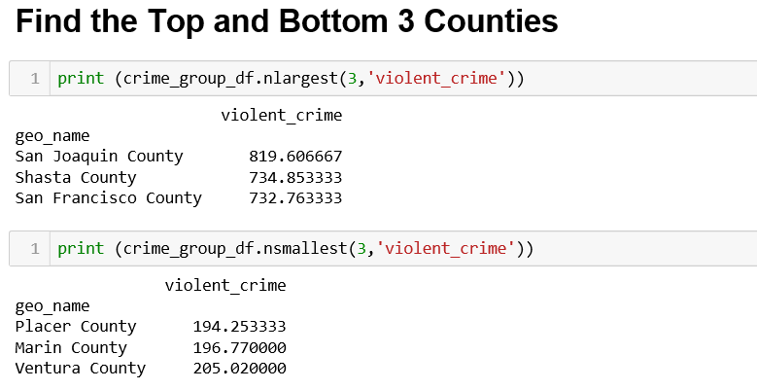
Find Top and Bottom 3 Counties

Slide 15
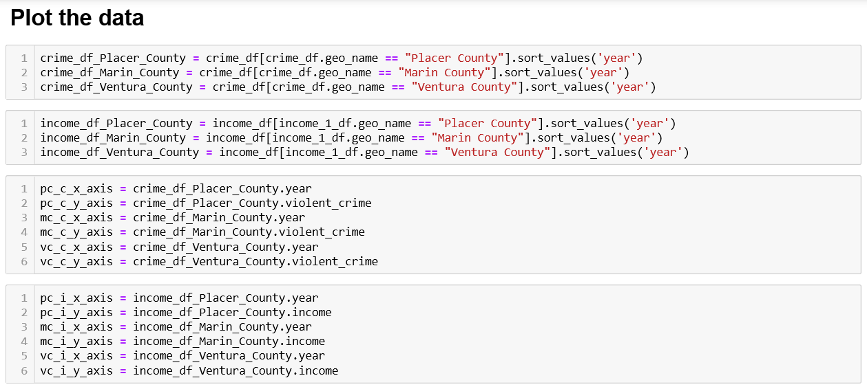
Plot the data

Slide 16
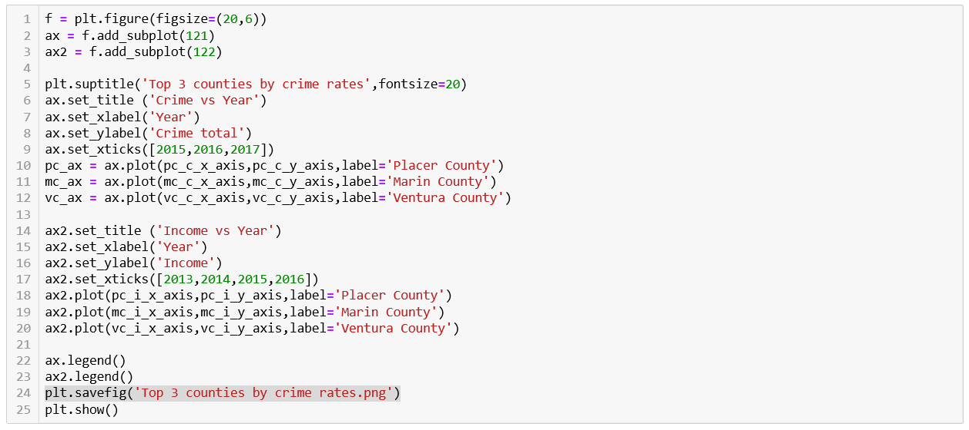
Plot the data

Slide 17
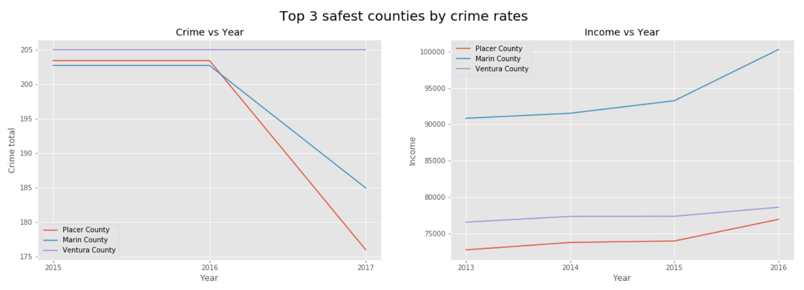
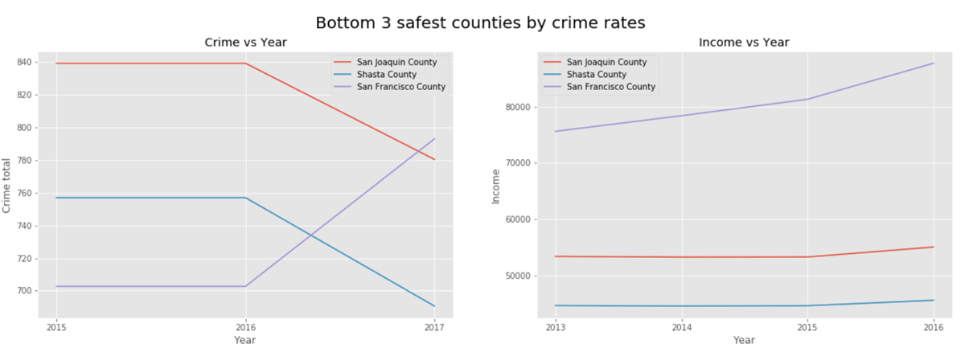
Top and bottom 3 counties by crime rates

Slide 18
EDUCATION
Zaid

Slide 19
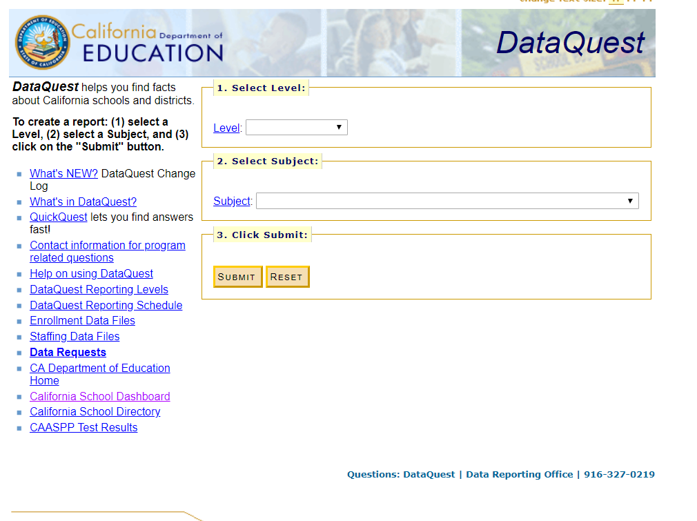
Education Data
DataQuest- Department of Education

Slide 20
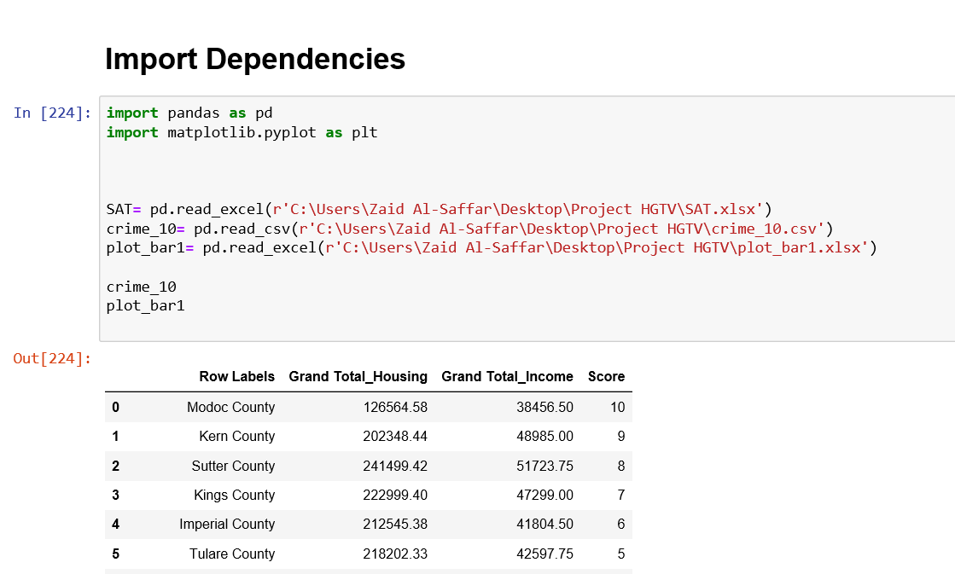
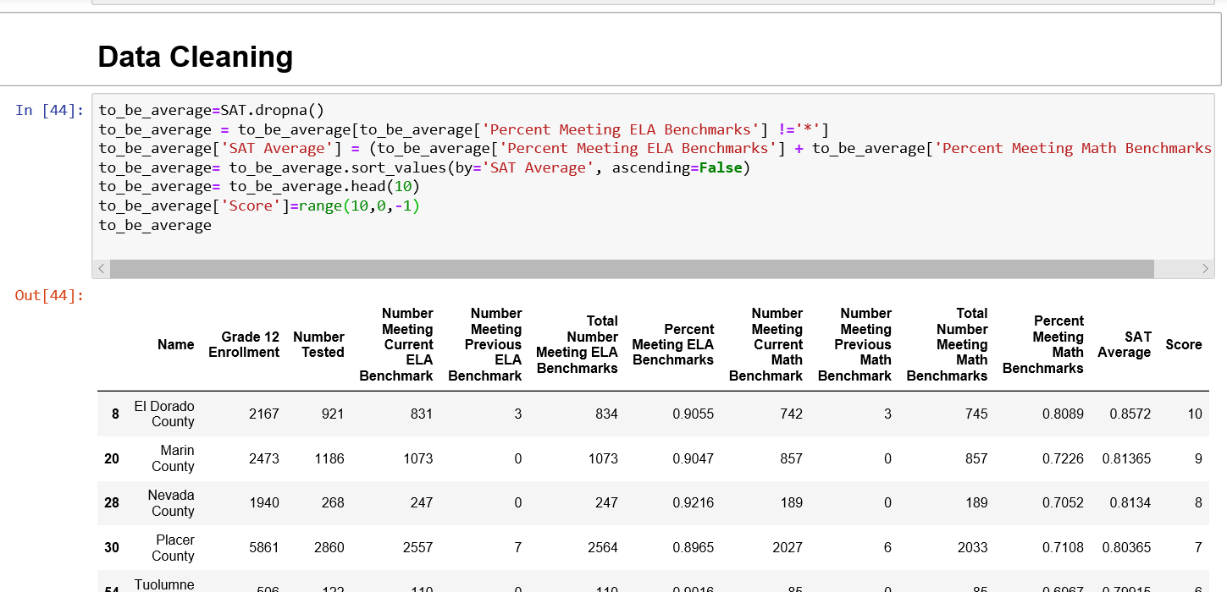
Import Data into Pandas DataFrame and Cleaning the Data

Slide 21
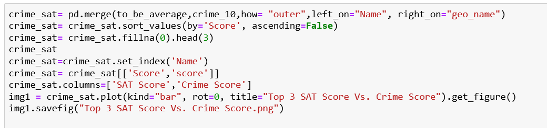
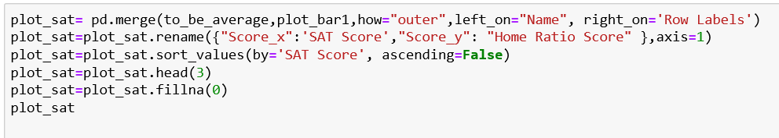
Data Merging

Slide 22
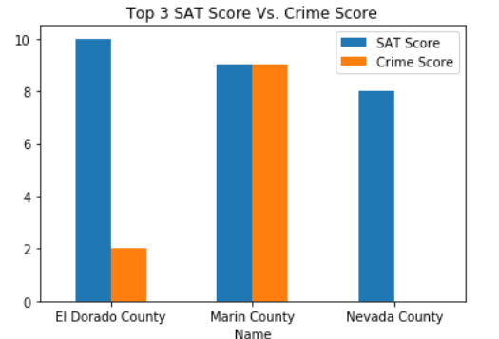
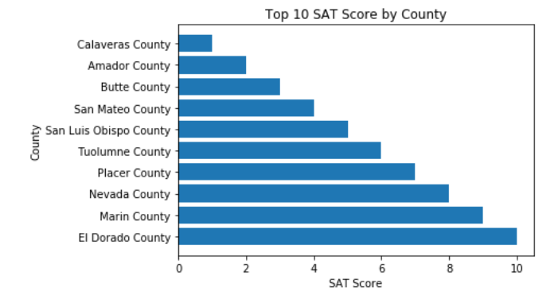
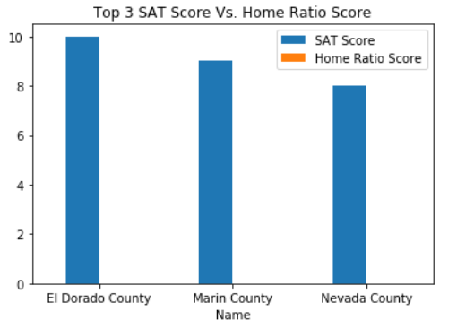
Plotting

Slide 23
Final Analysis

Slide 24
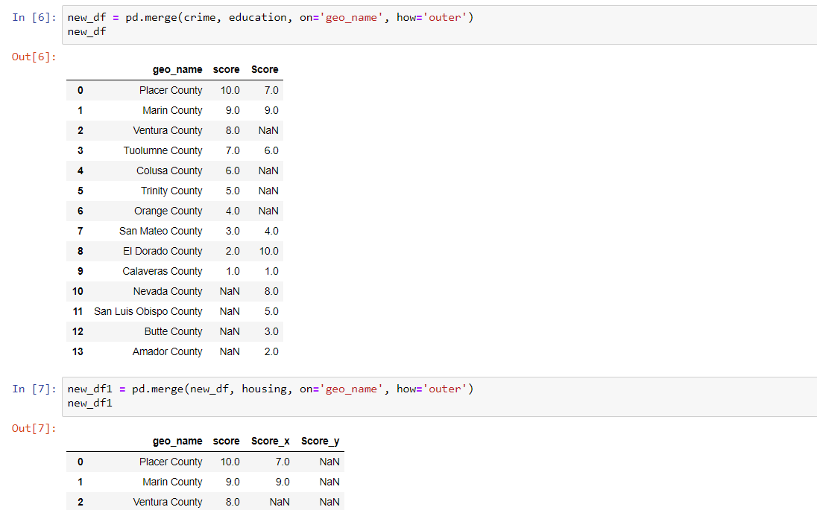

Slide 25
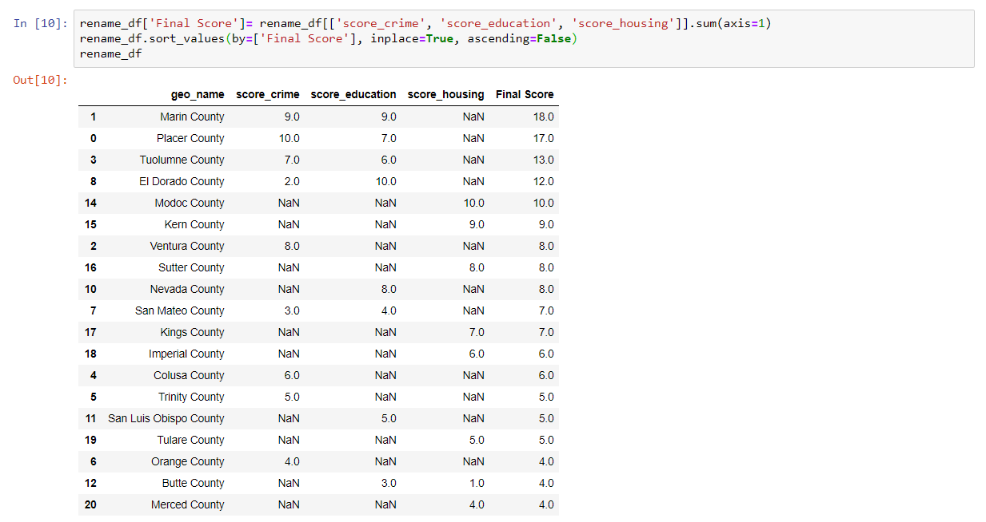

Slide 26
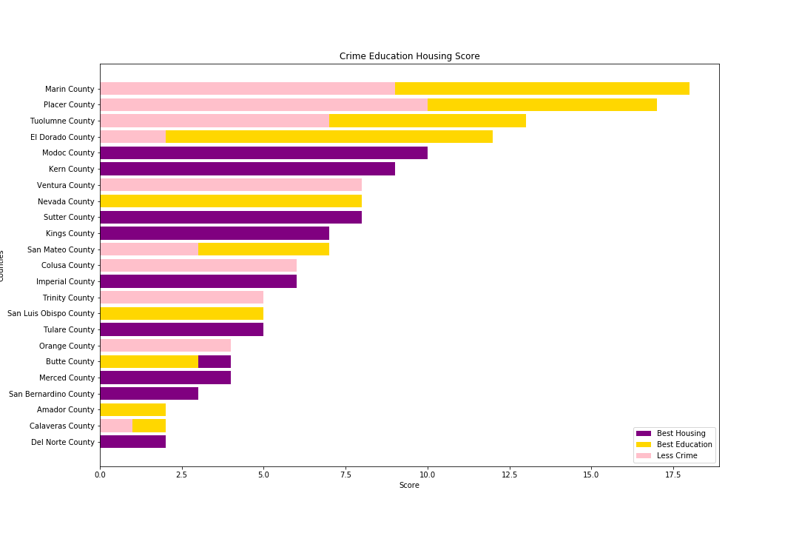
Overview

